Slide 1
Data Structures
K.P.I Shenesh Perera
IDM

Slide 2
Contents
Justification
Big(O) graph of Elements against Operations
BST vs. Hash Tables
BST vs. Heaps
BST vs. RBTs
BST vs. Linked Lists
BST vs. Graphs
Comparisons of performance and how efficient a data structure is will be made with the help of the Big O algorithm.

Slide 3
Justification
This presentation will compare the binary search tree data structure against comparable data structures.
As such a BST will not be compared with a data structure like a stack, because these 2 data structures were introduced to solve different problems, therefore have different use cases and ultimately are not comparable on a sensible basis.
All the comparisons in this presentation are industrially active and are vastly in use, which make them perfect candidates to be introduced to, you, new programmers.

Slide 4
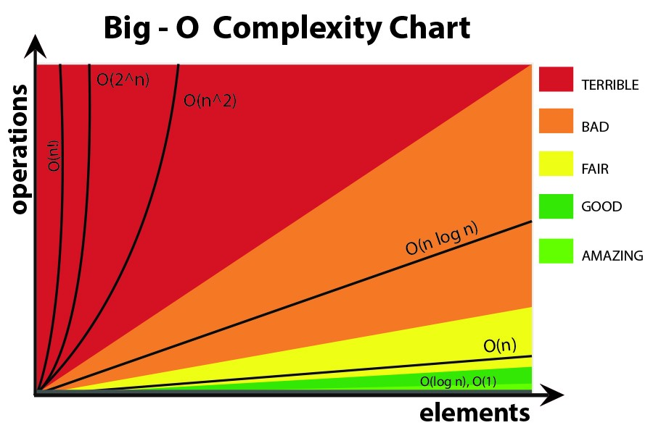
Figure 0.1, medium.com, Aleks Shineleva, 07/05/2016
Although not mentioned in the above graph, O(1) falls under “amazing” category, making constant time complexity the best.
Notes:
Please reference this graph when time complexity of a data structure is mentioned at any point.

Slide 5
Binary Search Trees
A BST is a node-oriented tree type data structure that has a particular set of rules that binds to the tree, as such there are certain naming conventions;
The first node in the BST is called a “root”
A series of nodes is called a branch, the last node of a branch is called a leaf.
The node which attaches a node is called it’s a parent while the attached node is called a child.
With the 3 major rules that builds a BST;
The value in the left node must always be lesser than the value of the key node.
The value in the right node must always be greater than the value of the key node.
The branches following a particular node must also obey the above rules.

Slide 6
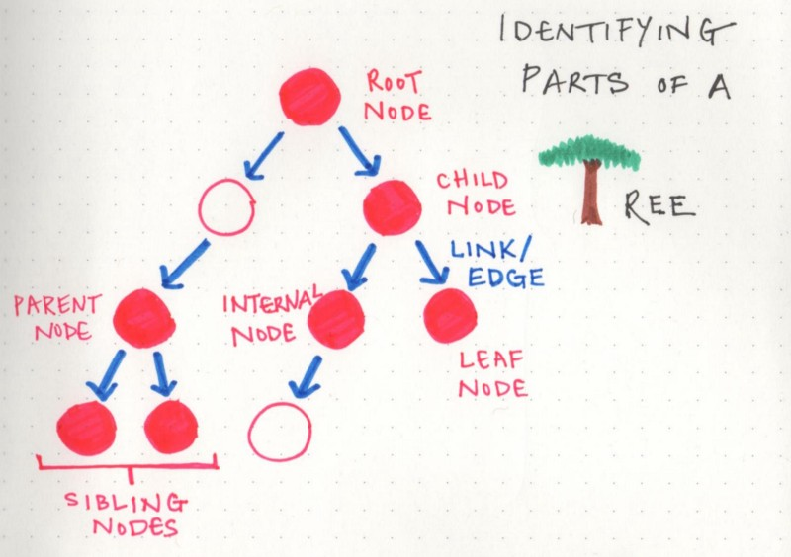
Figure 1.0, medium.com, Vaidehi Joshi, 2/13/2017

Slide 7
BST vs Hash Tables
Binary search trees, perform the general 3 functions search, insert and delete in the time complexity of O(n) where n is the number of nodes, but Hash tables provide these features at O(1) time complexity.
Even if it were a self balancing BST, these general functions are performed at O(logn)
As such Hash Tables generally perform better than BSTs.

Slide 8
However, there are very obvious use cases of BSTs that triumph over Hash tables.
In-order traversal in a BST provides data in a sorted manner, which is not native to hash tables.
BSTs are easier to implement than a hash table, even if it’s a custom BST. Hash tables require hashing, which usually require a 3rd party library.
Performing range queries, finding max, min or smallest value already exist in a BST while a Hash table doesn’t.
4. BSTs require balancing so as to not increase overhead. Hash tables do not require balancing.
Generally, BSTs and Hash tables are used in many languages to implement maps or sets.

Slide 9
BST vs Heaps
Function | Complexity | BST | Heap
Insert | Worst | o(log(n)) | o(log(n))
Search | Worst | o(log(n)) | o(n)
Max | Worst | o(1) | o(1)
Create | Worst | o(n(log(n))) | o(n)
Delete | Worst | o(log(n)) | o(log(n))
Table 1.0, Shenesh Perera, 28/11/2018
For the sake of this comparison, the balanced BST will be talked about, since asymptotically the normal BST becomes incomparable to heaps.
For the above functions all the average case scenario are the same except for insert.
As seen above generally a heap performs better than a BST which is due to overhead created by maintaining the order in a BST.
Notes:
A balanced BST is used here since when looked at it mathematically, the unbalanced BST is vastly inferior to the heap almost as if they can not be compared.
The table consists of information that I personally have gathered through implementations and performing mentioned functions on multiple data sets mainly consisting of integers as such depending on your personal implementation and what procedures you use, the performance may vary but will not exceed a margin that is significant enough to be considered as a means to debate.

Slide 10
The main reason why I suggest using heaps over BST is because insertion to a heap in average case is o(1) while for a BST it’s o(log(n)). Specially the Fibonacci heap. So if the situation requires a lot of insertion then a heap is a better choice.
Heaps can be implemented using dynamic arrays or a pointer oriented tree but a BST can only be implemented using a pointer oriented tree.
The creation time complexity for a BST is at worst case o(log(n)) while for a heap it’s o(n) which makes both a BST or a heap a suitable choice if a multiple new BSTs or heaps are created.
Searching for a random value has time complexity o(log(n)) in a BST but for a heap it’s o(n). If data is constantly searched for, then a BST is better.
Notes:
Regarding the last point, although this is true if we were talking about searching for the LARGEST value then a hash table will have a time complexity of o(1) while BST will stay at o(log(n)).

Slide 11
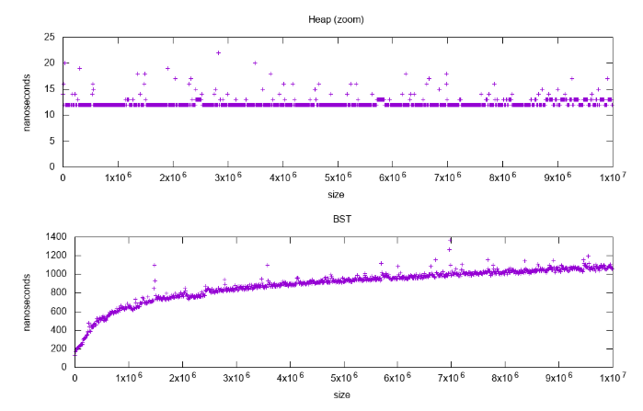
Figure 1.1, Shenesh Perera, 28/11/2018
The above graph has been plotted by populating std::set(2nd graph) and a std::priority_queue(1st graph) fromC++ to validate the time complexity of insertion, and as you see for a heap its o(1)/constant and for a BST it’s o(log(n))/logarithmic.
Notes:
The tests were done using the standard GCC C++ library, where std::set is confirmed to be an Red&Black based BST while the std::priority_queue is said to be a dynamic array heap.
The code I wrote to produce these results have been left out as the scope of this presentation is not about code.
The reason I’ve chosen a size against time graph instead of a elements against number of operations graph in this case is simply because it’s easier to observe time complexity(which is mathematically a form of rate).
Number of operations against elements have a somewhat vague implication, in order to give the best possible demonstration a graph like this was plotted.

Slide 12
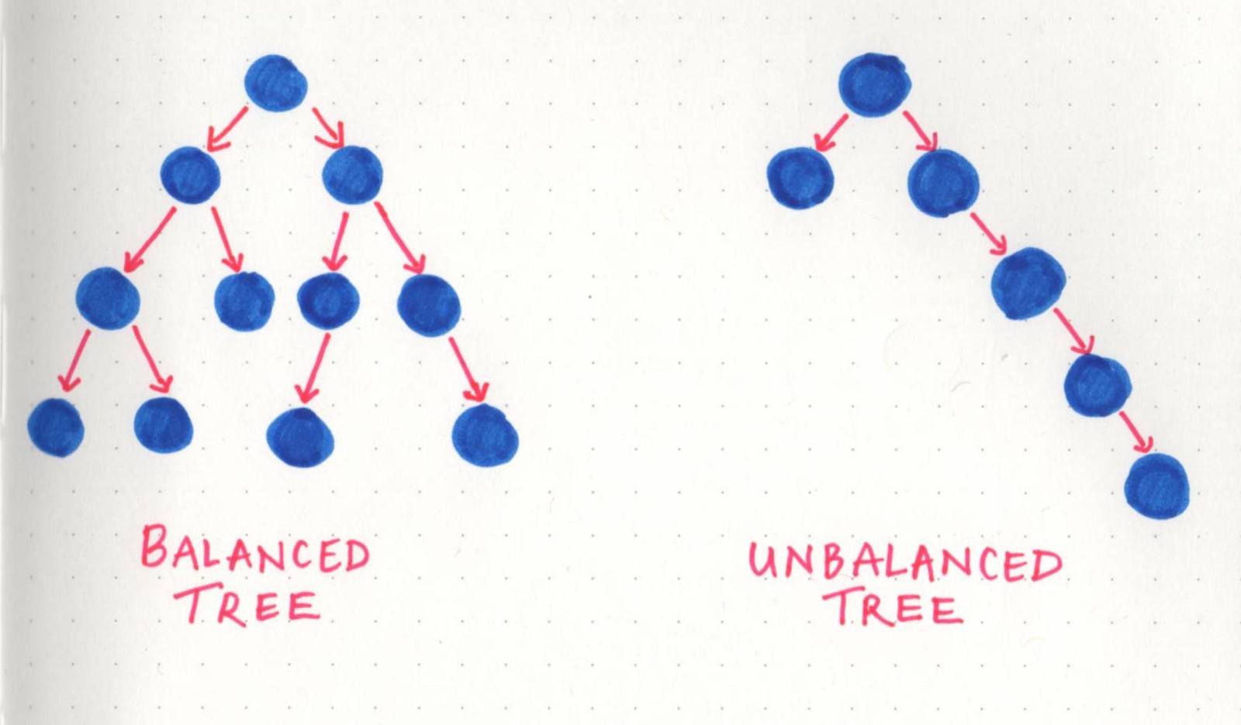
BST vs Red-black tree
Figure 1.2, medium.com, Vaidehi Joshi, 2/13/2017
A red-black tree is a self balancing tree unlike binary-search, so the time taken to perform searches and insert are much lower in RBT than a BST.

Slide 13
An RBT is not an entirely different data structure, it retains the same concepts and contains the properties of a BST but due to it’s self-balancing feature, an RBT tends to have time complexity that is logarithmic while BSTs with their long branches tend to have a linear time complexity.
As such a RBT can be said to be generally faster but this boost in speed can only be noticeable with large number of nodes.
All functions search, insert etc. are noticeably but not significantly faster for few nodes.
Be it worst or best case time complexity, an RBT is logarithmic- o(log(n)) while a BST will be logarithmic in the worst case and constant in best case.

Slide 14
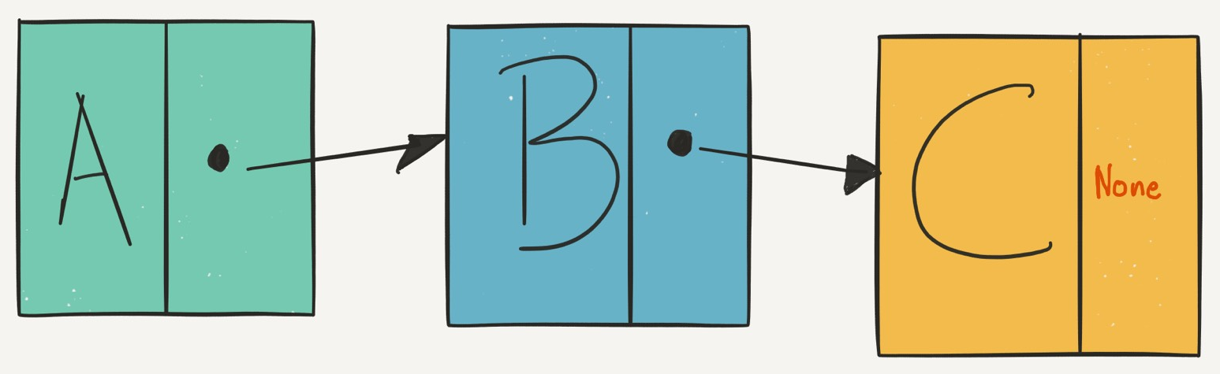
BST vs Linked List
A linked list has all it’s items linked together one after another, so the higher number of items the longer the access path.
However given that the BST is balanced, the access path could be considerably lesser than when a linked list is concerned.
Figure 1.3, dbader.org, Dan Bader, 03/08/2018

Slide 15
A linked list is a fundamental type of data structure, so usually it is used to implement other data structures even a BST, so why compare these 2?
Simply, because implementing a BST using a linked list is inefficient despite the type of linked list involved.
True, a linked list is pointer-based but a BST is a pointer-based tree, as such the time complexity gradually tends to y axis in a graph of operations against elements.

Slide 16
BST vs Graphs
Trees in general are a more restricted version of a graph, this theory applies to BSTs as well.
A BST and all trees are categorized as Directed Acyclic Graphs, or DAGs for short.
A common misconception is that new programmers that have learnt about graphs, tend to think that BSTs do not have a direction restriction, which is false. BSTs do have a direction, but not in the way that A goes to B, but that A is a parent of B or B is a child of A, a direct relationship is established.
Due to this false misconception, new programmers tend to avoid BSTs.

Slide 17
BSTs are considerably less complex than a graph, as a BST does not have loops, circuits etc.
BSTs fall under hierarchical model, while a graph falls under the network model.
Graphs do not contain the concept of a “root”, they also do not have a parent-child relationship with each element.
While graphs have no restrictions in terms of connecting with edges, BSTs do as have been pointed earlier.
Graphs are categorized as directed and undirected, and employ a concept of “edges” and “vertices”

Slide 18

Figure 1.4, stackexchange.com, coding_ninza, 15/06/2018
Graphs are usually implemented using multi-dimensional arrays, which is called an adjacency matrix or adjacency list if implemented using a linked list.
Implementing a graph must be carefully thought, due to the complexity of the data structure, for a new programmer it is much recommended to go for a BST instead.

